Slide 1
HR Analytics: Employee Attrition and Retention Analysis
InternNova Internship — Week 6 Final Data Analytics Project
Presented by: Sushma Sakry

Slide 2
Project domain: Human Resources Analytics
Main focus: Understanding employee attrition and identifying potential retention risks.
Dataset: Employee-level HR data containing demographic, job-related, satisfaction, compensation, and tenure information.
Starting dataset: 1,480 rows and 38 columns.
Final cleaned dataset: 1,473 rows and 35 columns.
Deliverables: Cleaned dataset, exploratory data analysis, five visualizations, Power BI dashboard, insights, and recommendations.
Project Overview

Slide 3
Employee turnover can increase recruitment costs, disrupt team productivity, and cause organizations to lose experienced employees. HR teams need to understand which employee groups have higher attrition and which workplace factors may be associated with employees leaving.
Project objectives
Measure the overall employee attrition rate.
Compare attrition across departments, age groups, job roles, and overtime status.
Clean and validate the dataset before analysis.
Identify patterns that may help HR teams improve employee retention.
Build an interactive Power BI dashboard to support data-driven decisions.
Business Problem & Project Objectives
Problem Statement

Slide 4
Data quality check Before cleaning After cleaning
Total records 1,480 1,473
Total columns 38 35
Duplicate rows 7 0
Missing values 57 in YearsWithCurrManager 0
Constant columns 3 Removed
Cleaning steps performed
Removed 7 exact duplicate rows.
Replaced 57 missing values in YearsWithCurrManager with the median.
Standardized TravelRarely to Travel_Rarely.
Removed EmployeeCount, Over18, and StandardHours because they contained constant values.
Rechecked the cleaned dataset for missing values and duplicates.
Dataset Overview & Data Cleaning

Slide 5
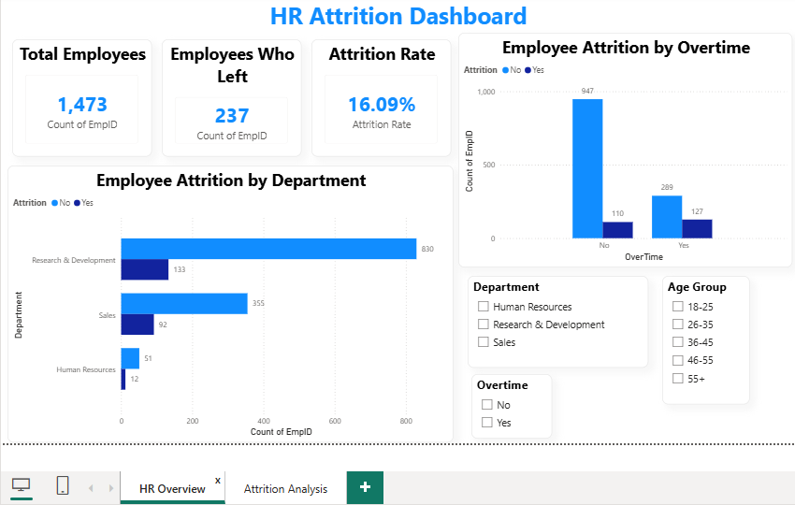
Key findings
1,236 employees stayed, representing 83.91% of the cleaned dataset.
237 employees left, representing 16.09%.
Research & Development had the largest workforce, with 963 employees.
Sales had 447 employees, while Human Resources had 63.
Understanding Employee Attrition
Most employees stayed, but approximately 16 out of every 100 employees in the dataset left.

Slide 6
Department / category Attrition rate
Sales 20.58%
Human Resources 19.05%
Research & Development 13.81%
Overtime: Yes 30.53%
Overtime: No 10.41%
Where Is Attrition Higher?
Key takeaways
Sales had the highest attrition rate among the three departments.
Employees who worked overtime had a higher observed attrition rate than those who did not.
The overtime group’s attrition rate was approximately three times that of the non-overtime group.

Slide 7
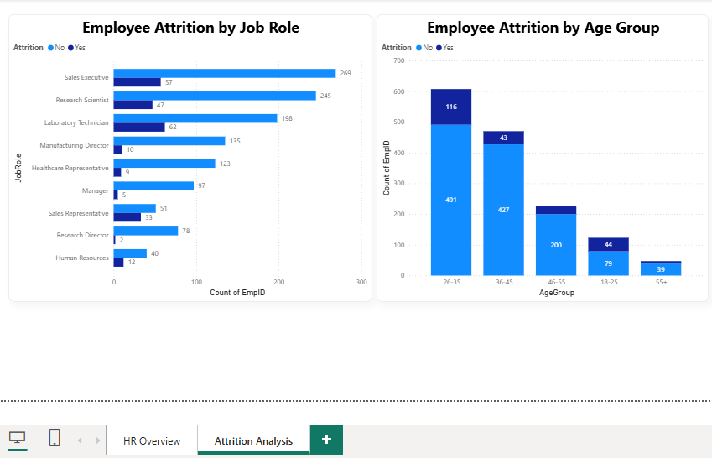
Key findings
The 18–25 age group had an attrition rate of 35.77% (44 out of 123 employees).
Sales Representatives had the highest job-role attrition rate at 39.29% (33 out of 84 employees).
Laboratory Technicians had an attrition rate of 23.85%.
Human Resources employees had an attrition rate of 23.08%.
Research Directors had the lowest job-role attrition rate at 2.50%.
Attrition rates varied considerably by age group and job role, suggesting that retention strategies may need to be tailored to different employee segments.
Which Employee Groups Show Higher Attrition?

Slide 8
1. Overall attrition
237 out of 1,473 employees left, giving an overall attrition rate of 16.09%.
2. Overtime pattern
The overtime group had a 30.53% attrition rate, compared with 10.41% for employees who did not work overtime.
3. Department differences
Sales recorded a 20.58% attrition rate, higher than Research & Development at 13.81%.
4. Age-group difference
Employees aged 18–25 had a 35.77% attrition rate in this dataset.
5. Job-role variation
Sales Representatives recorded a 39.29% attrition rate, while Research Directors recorded 2.50%.
Key Findings & Patterns

Slide 9
Interactive HR Analytics Dashboard

Slide 10
Dashboard features
Three KPI cards: Total Employees, Employees Who Left, and Attrition Rate.
Department and overtime attrition comparisons.
Age-group and job-role attrition analysis.
Slicers for interactive filtering.
Two report pages: HR Overview and Attrition Analysis.

Slide 11
Recommendations
Recommendations
1. Review overtime practices
Examine workloads, overtime frequency, staffing levels, and employee feedback to identify potential retention risks.
2. Strengthen retention in Sales
Investigate exit-interview feedback, compensation, career development, and manager support in the Sales department.
3. Support early-career employees
Explore mentoring, onboarding, career pathways, and regular engagement discussions for younger employees.
4. Monitor job-role trends
Track attrition rates by role over time and investigate roles with unusually high rates.

Slide 12
Conclusion
Cleaned and analyzed 1,473 employee records.
Identified differences in attrition by overtime status, department, age group, and job role.
Built an interactive Power BI dashboard for HR analysis.
Developed actionable recommendations to support employee retention.

Slide 13
Thank you!

